Slide 1

Intro to Cyber Security
Mohie Eldean Ehab Badawy

Slide 2
Agenda for today
Why cyber security
Difference between safety and cyber security
Cyber security stack (Crypto stack)
ENCRYPTION VS VERIFICATION
examples on Cyber Security algorithms
Symmetric vs Asymmetric keys Algorithms
What is Encryption ?
Stream Cipher vs Block Cipher
Padding schemes for Block Cipher

Slide 3
Why
Cyber Security
Today, cars contain up to 150 electronic control units and about 100 million lines of software code – four times more than a fighter jet –, projected to rise to 300 million lines of code by 2030.
automotive manufacturers must comply with the United Nations Economic Commission for Europe (UNECE) Regulation WP.29/R155
ISO/SAE 21434 (Road vehicles – Cybersecurity Engineering) and UNECE WP.29 (Regulation on Cybersecurity) are examples for the regulations needed for the manufacturers to comply to.

Slide 4
Functional Safety and Cyber Security
The difference between functional safety and cyber security is “calculated risk”
Compared to safety, security is a rather fast-moving discipline.
Especially due to the increase in networked components, security is increasingly coming into focus.
the danger increases steadily and previously successfully implemented countermeasures may no longer be sufficien
Safety is distinguished by a very static character.

Slide 5
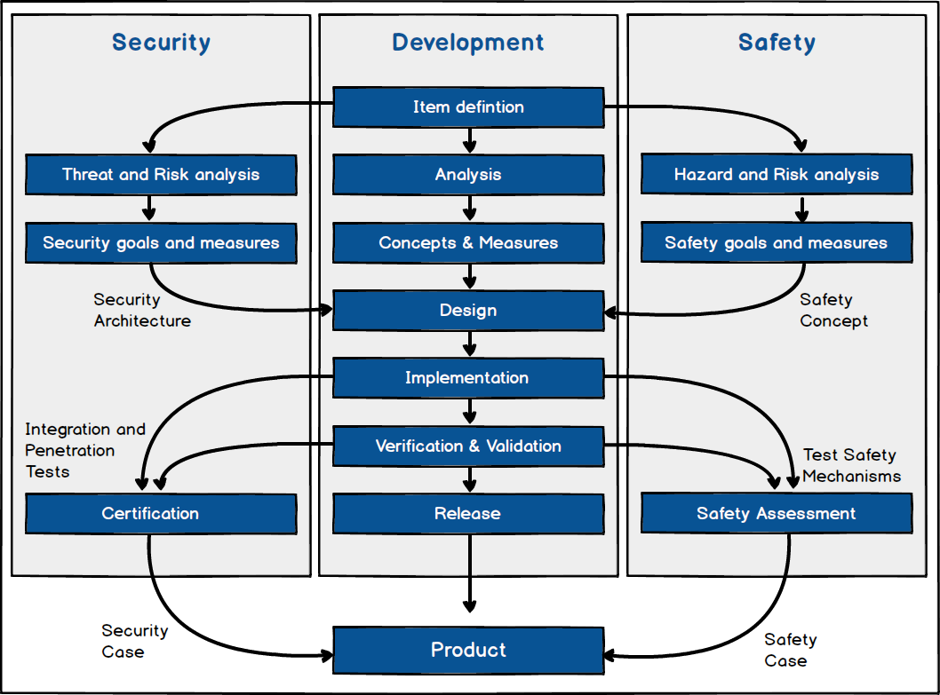

Slide 6
examples on Cyber Security algorithms
Symmetric cryptography
AES
Asymmetric cryptography
Hash-function
ECC
DES
RSA
SHA-2
MD5

Slide 7
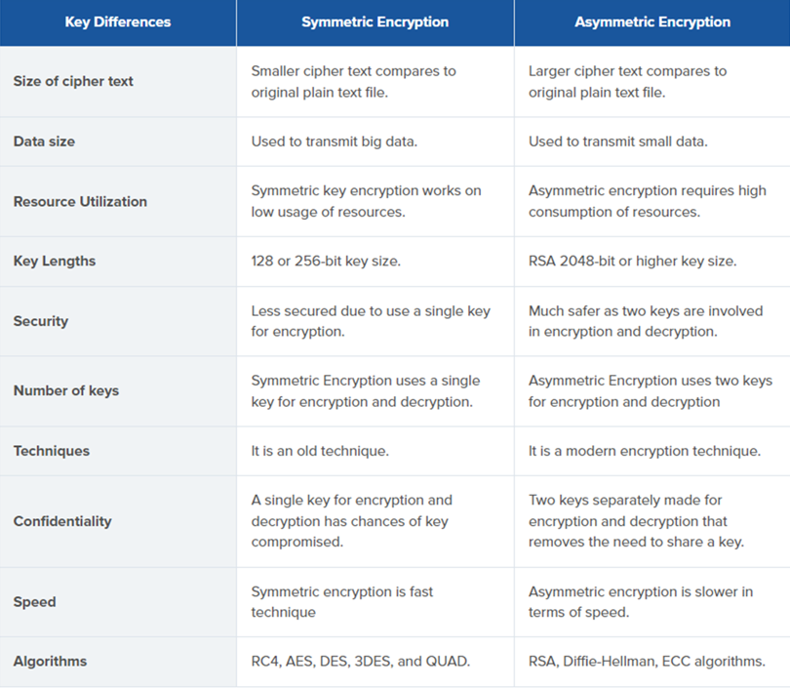

Slide 8
ENCRYPTION
This process converts the original representation of the information, known as plaintext, into an alternative form known as ciphertext.
ENCRYPTION ALGORITHM : AES , RSA
To Encrypt a plaintext we need :
DATA MODE : CBC , EBC

Slide 9
CRYPTOGRAPHY MODES
BLOCK CIPHER
ECB
CBC
STREAM CIPHER

Slide 10
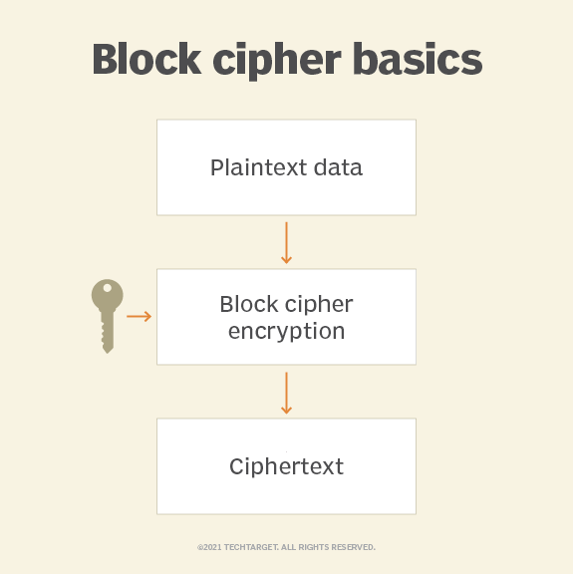
ECB

Slide 11
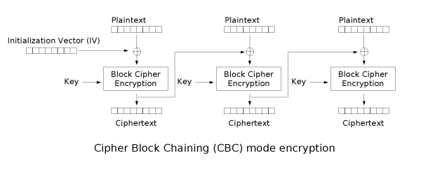
CBC

Slide 12
Padding schemes for block ciphers
To perform encryption with a block cipher in ECB or CBC mode the length of the input to be encrypted must be an exact multiple of the block length B in bytes.
For Triple DES the block length B is 8 bytes (64 bits) and for all AES variants it is 16 bytes (128 bits).
If the length of the data to be encrypted is not an exact multiple of B, it must be padded to make it so.
After decrypting, the padding needs to be removed.
The most popular is "PKCS5" padding also there is OneAndZeroes Padding.

Slide 13
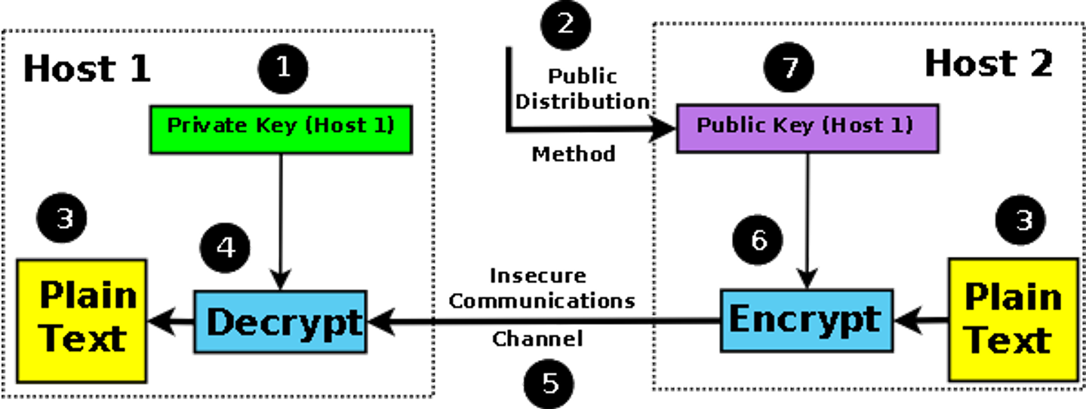
ENCRYPTION

Slide 14
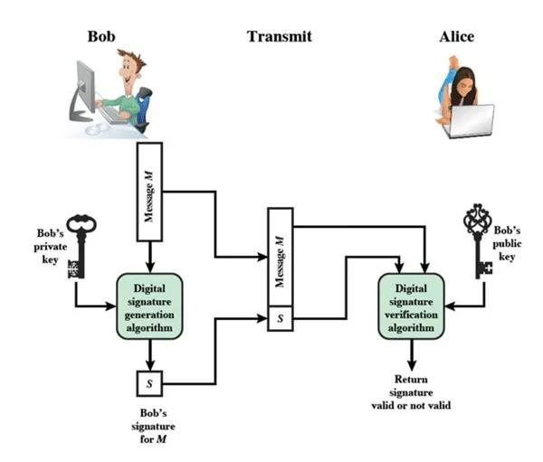
VERIFICATION AND AUTHENTICATION

Slide 15
BREAK….

Slide 16
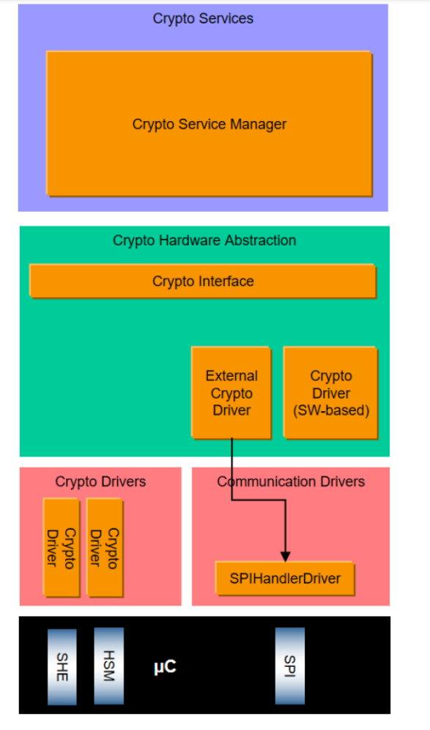
CRYPPTO STACK
CSM
CryIf
Crypto Drive : -Software Library -Hardware Library "HSM"

Slide 17
CSM Crypto Service Manager
Crypto Service Manager (CSM) is a Service layer module which provides standard interface to the application to access basic cryptographic services provided by the Software/Hardware crypto driver.
These services can be accessed by application synchronously (services are completed when the function returns) or asynchronously (callback routine is called on completion of the service).

Slide 18
CSM
PRIMITIVES
KEY MANAGEMENT
JOBS
KEYS

Slide 19
Key Management
Gen Set-Key
Get - Key
Set-Key-Valid

Slide 20
JOBS
Decryption
Hash
Sign verification
CMAC
Encryption

Slide 21
CryIF Crypto Interface
Crypto Interface (CryIf) is an ECU abstraction layer module which abstracts the services provided by the low level Software or Hardware driver from CSM.
so that CSM can provide a standardized interface to the application.
It gives interfaces to be used by the application through the CSM
These interfaces are actually implemented in the in the Crypto Driver (found in the MCAL layer of the Same ECU) or from External Crypto Driver (from another ECU)

Slide 22
Crypto Driver
Crypto Driver is an MCAL module which has an implementation for a cryptographic service.
Hardware is also used to provide the functionality but it is then mostly accessed using an SPI handler.
It can be software or a hardware module.

Slide 23
Key elements
Initialization vector
modulus
Exponent
key

Slide 24
Key element
Key type
Key from key type
Crypto primitives

